Slide 1
Environmental Protection
Ozone Depletion
Acid Rain
Water & Wastewater
Pollution
Resource Depletion
Climate Change

Slide 2
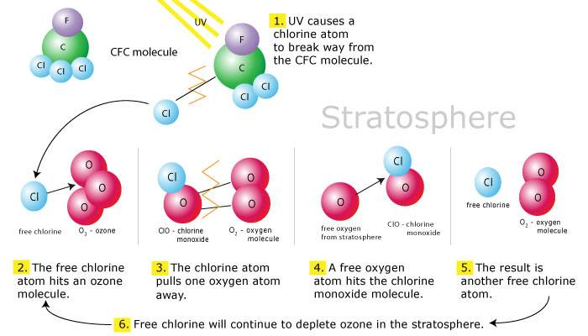
Ozone Depletion
www.learner.org

Slide 3
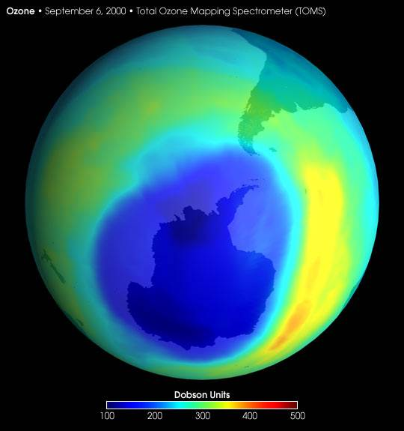
Ozone Depletion
earthobservatory.nasa.gov

Slide 4
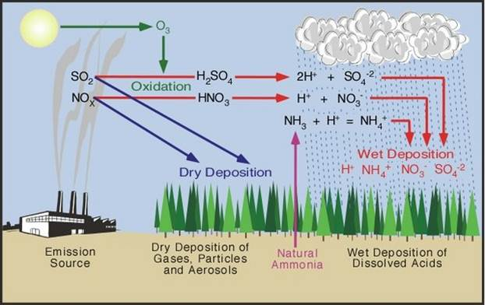
Acid Rain
www.eoearth.org

Slide 5
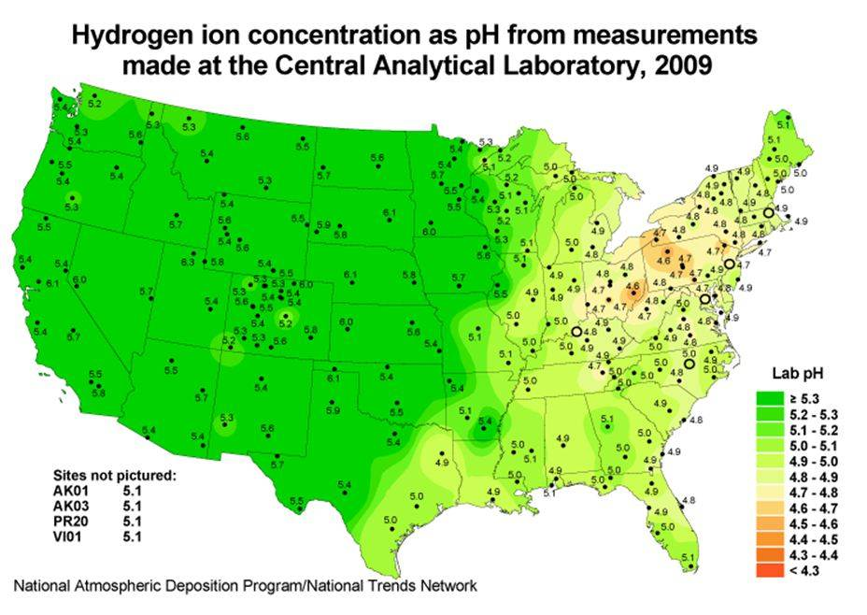
www.eoearth.org

Slide 6
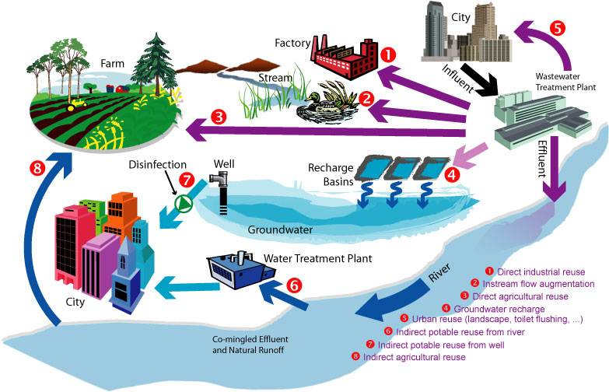
Water & Wastewater
Developed World
cdn3.blogs.babble.com

Slide 7
Water and Wastewater
Developing World
UN Millennium Development Goals
  Reduce by half proportion of people without sustainable access to safe drinking water (2015)
    1 B people lack access to safe drinking water, 2.4 B to adequate sanitation
Flying Toilet
  Poop in plastic bag, throw bag as far as you can
www.un.org/millenniumgoals/

Slide 8
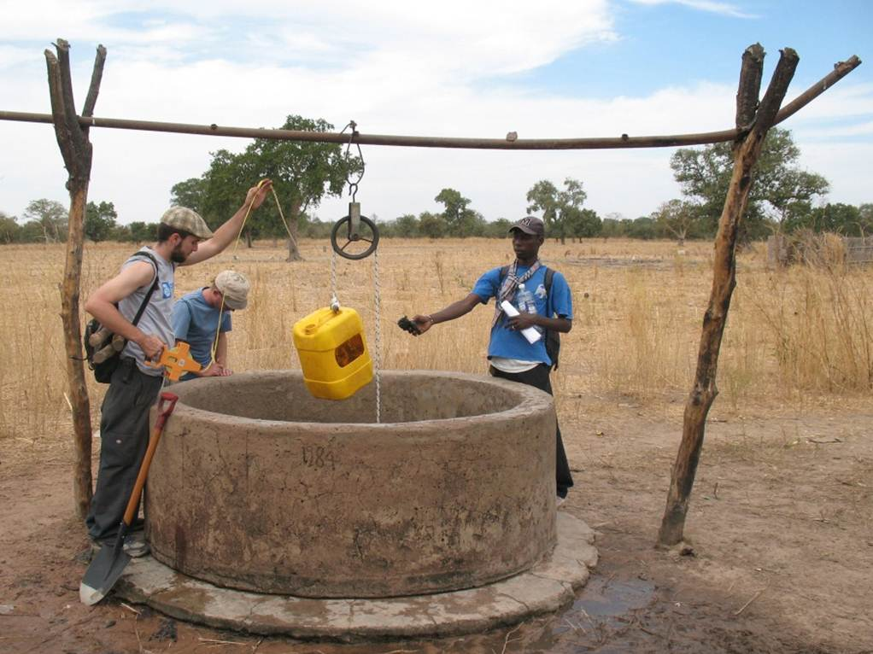
The Gambia

Slide 9
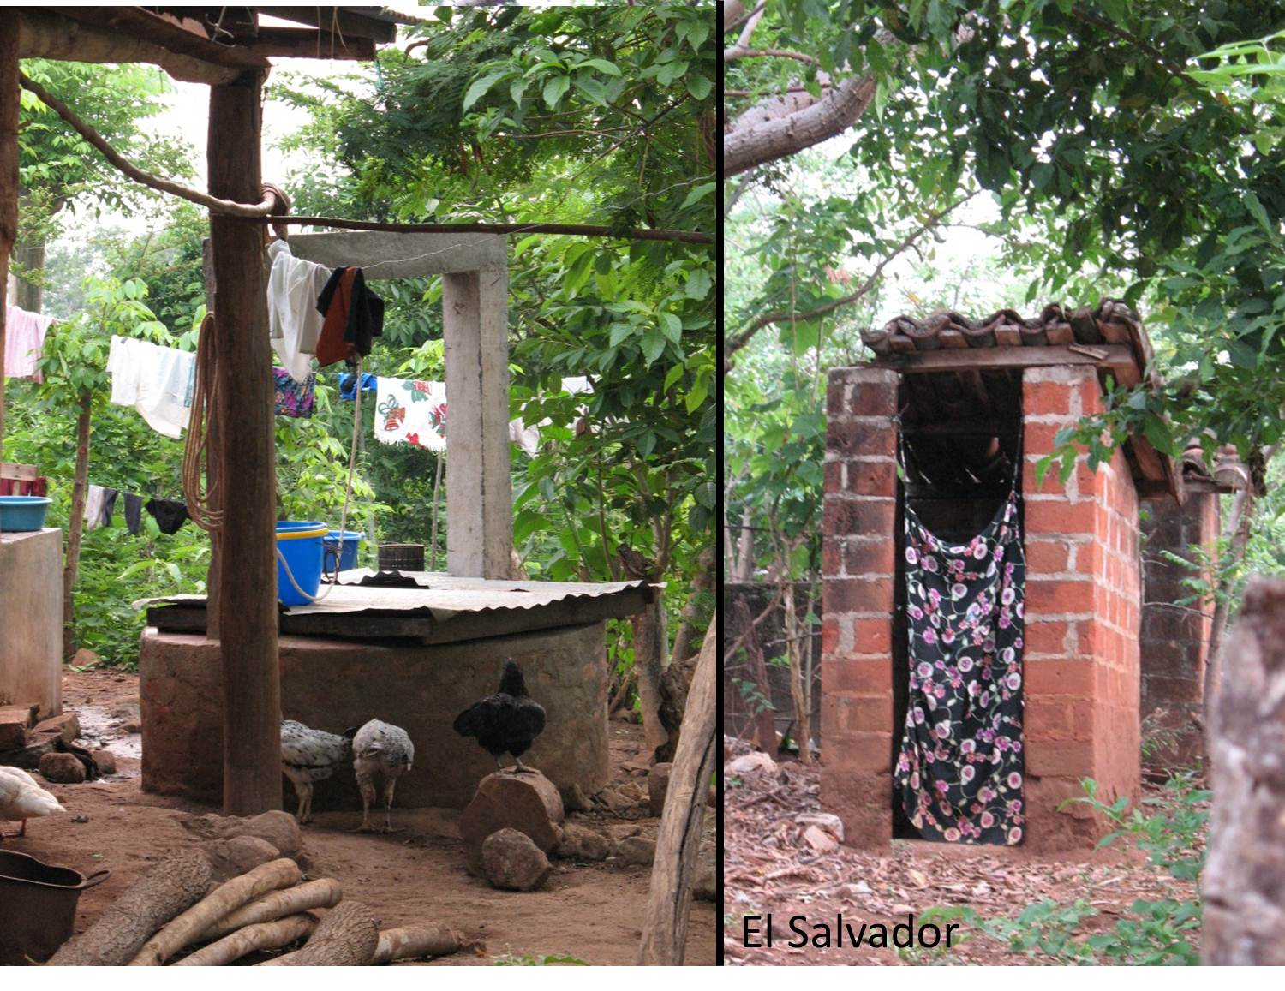

Slide 10
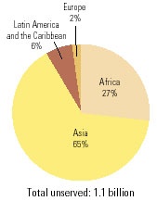
Population with out Water Supply
www.unesco.org
Europe
2%
Latin America
& Caribbean
6%
Africa
27%
Asia
65%
Total not served: 1.1 Billion

Slide 11
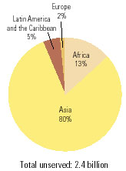
Population without Water Sanitation
www.unesco.org
Latin America
& Caribbean
5%
Europe
2%
Africa
13%
Asia
80%
Total Not served: 2.4 Billion

Slide 12
Water & Health
Diarrhoeal disease
  6,000 deaths / day (most children under five)
  1.96 M deaths / year (2001)
  Most attributed to 'water, sanitation and hygiene'
  Preventable with simple hygiene
    wash hands after using toilet or before preparing food
Schistosomiasis (bilharziasis)
  >200 M people worldwide infected
  88 M children <15 years are infected each year with schistosomes.
  80% of transmission takes place in Africa south of the Sahara.
Lymphatic filariasis
  ~119 M people infected globally (40 M suffer have chronic form)
Malaria
  >1 M people die from malaria / year
    ~90% in Africa south of Sahara.
  >300 million cases of acute illness each year
  Mortality increased 27% from 1990 and 2002
Africa
  97% of world's onchorocerciasis ( parasitic infection)
  88% of world's malaria
  78% of world's schistosomiasis
  52% of world's trachoma burden.
Bangladesh
  > 4 million tubewells installed over past 20 years
  High concentrations of arsenic provoked largest mass arsenic poisoning in history
South-East Asia
  62% of world's dengue
  56% of world's lymphatic filariasis.
webworld.unesco.org/water/wwap/facts_figures/basic_needs.shtml
Notes:
Schistosomiasis, also known as bilharziasis or snail fever, is a primarily tropical parasitic disease caused by the larvae of one or more of five types of flatworms or blood flukes known as schistosomes. The name bilharziasis comes from Theodor Bilharz, a German pathologist, who identified the worms in 1851 (medical-dictionary).
Lymphatic filariasis - a disease caused by filarial worms transmitted by mosquitoes: the worms invade lymphatic vessels and lymphoid tissue, causing chronic swelling of the lower extremities and other parts of the body (www.yourdictionary.com)
Globally, diarrhoeal diseases and malaria accounted for, respectively, 4% and 3% of disability-adjusted life years (DALYs) lost, and 1.8 and 1.3 million deaths in 2002. This burden is almost entirely limited to the under-five age group.
Diarrhoeal diseases
- Every day, diarrhoeal diseases cause some 6,000 deaths, mostly among children under five.
- In 2001, 1.96 million people died from infectious diarrhoeas; 1.3 million were children under five.
- Between 1,085,000 and 2,187,000 deaths due to diarrhoeal diseases can be attributed to the 'water, sanitation and hygiene' risk factor, 90 percent of them among children under five.
- With simple hygiene measures such as washing hands after using the toilet or before preparing food, most of these deaths are preventable.
Malaria
- Over 1 million people die from malaria every year.
- About 90% of the annual global rate of deaths from malaria occur in Africa south of the Sahara.
- Malaria causes at least 300 million cases of acute illness each year.
- Mortality due to malaria increased by 27% between 1990 and 2002, going from 926,000 people to 1,272,000.
- The disease costs Africa more than US$12 million annually and slows economic growth in African countries by 1.3% a year.
- Sleeping under mosquito nets would be one simple but effective way to prevent many cases of malaria, especially for children under five.
Africa accounts for 97% of the world's burden of onchorocerciasis (a parasitic infection), 88% of the world's burden of malaria, 78% of its schistosomiasis burden, and 52% of its trachoma burden.
Schistosomiasis (bilharziasis)
- More than 200 million people worldwide are infected by schistosomiasis.
- 88 million children under fifteen years are infected each year with schistosomes.
- 80% of transmission takes place in Africa south of the Sahara.
In Bangladesh alone, more than 4 million tubewells have been installed over the past twenty years to provide safe drinking water to 95% of the population. However, high concentrations of arsenic found in tubewell water provoked the largest mass arsenic poisoning in history.
South-East Asia accounts for 62% of the world's burden of dengue, and 56% of its burden of lymphatic filariasis.
An estimated 119 million people are infected with lymphatic filariasis globally, 40 million of whom suffer from the chronic form of the disease.
Africa accounts for 97% of the world's burden of onchorocerciasis (a parasitic infection), 88% of the world's burden of malaria, 78% of its schistosomiasis burden, and 52% of of its trachoma burden.

Slide 13
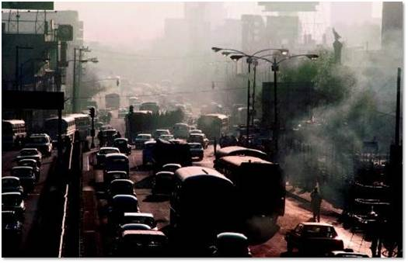
Pollution
Toxins
Smog, Particles, Acid Rain, Ozone Depletion
Mexico city:www.pollutionissues.com

Slide 14
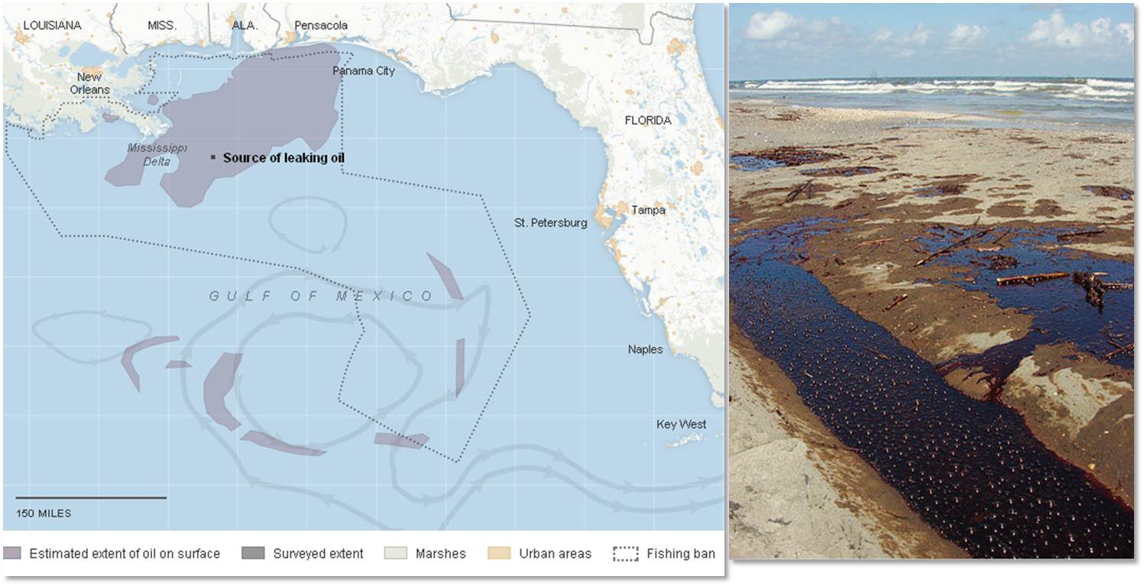
Spills
6/14/2010
www.oilism.com/oil/wp-content/uploads/2007/12/oilspill2.jpg
www.nytimes.com

Slide 15
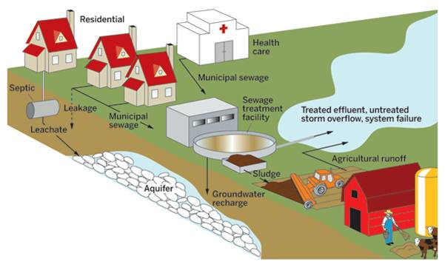
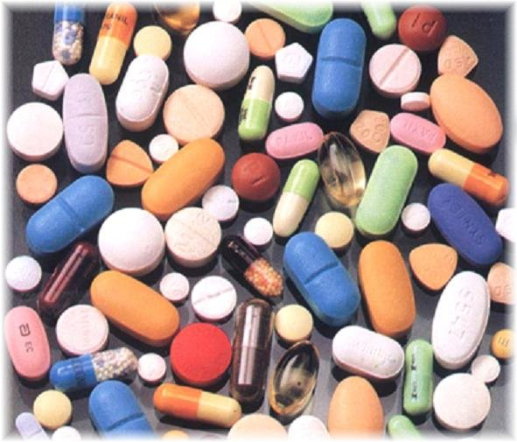
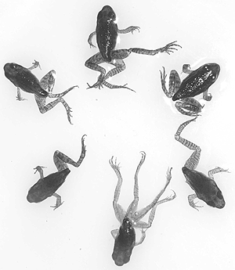
Pharmaceutical Pollution
pubs.acs.org
2.bp.blogspot.com
safelawns.org

Slide 16
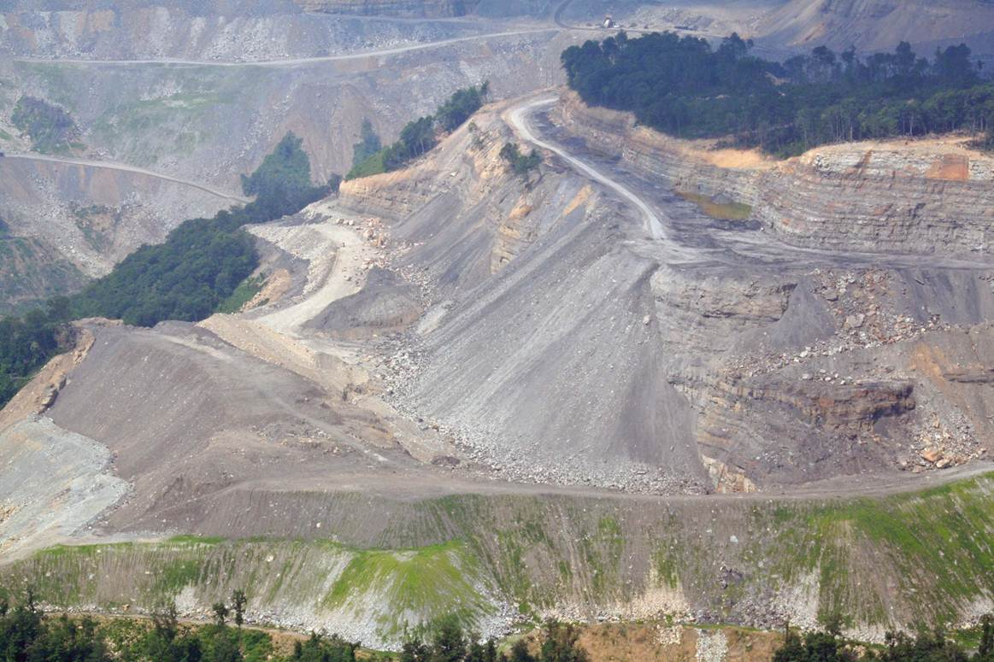
Natural Resource Extraction
Mountain top removal (Coal)
virginia.sierraclub.org

Slide 17
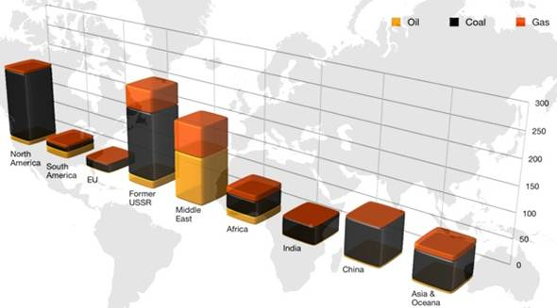
Oil, Coal & Gas Reserves
www.worldcoal.org, 2011 (World Coal Association)

Slide 18
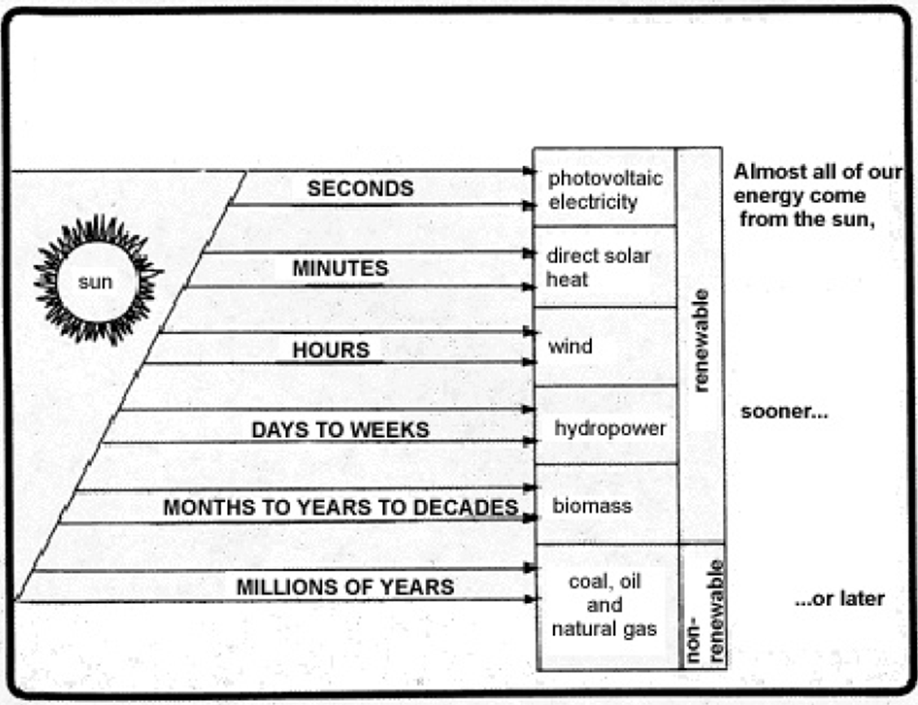
Renewable Energy
www.apsenergyconservation.org

Slide 19
Food and Water Resources
www.unesco.org
Product | Unit | Equivalent water in m³ per unit
Cattle | Head | 4,000
Sheep and goats | Head | 500
Fresh beef | Kg | 15
Fresh lamb | Kg | 10
Fresh poultry | Kg | 6
Cereals | Kg | 1.5
Citrus fruits | Kg | 1
Palm oil | Kg | 2
Puls, roots and tubers | Kg | 1

Slide 20
Metal / Glass / Paper
Limited amounts available with existing technology
Solutions
  Source Reduction
  Reuse
  Recycling

Slide 21
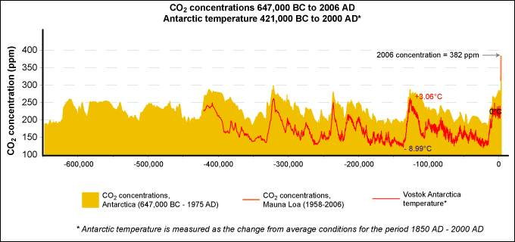
Human Caused Climate Change
CO₂ & Temp Over Time
www.epa.gov/climatechange/science/pastcc.html

Slide 22
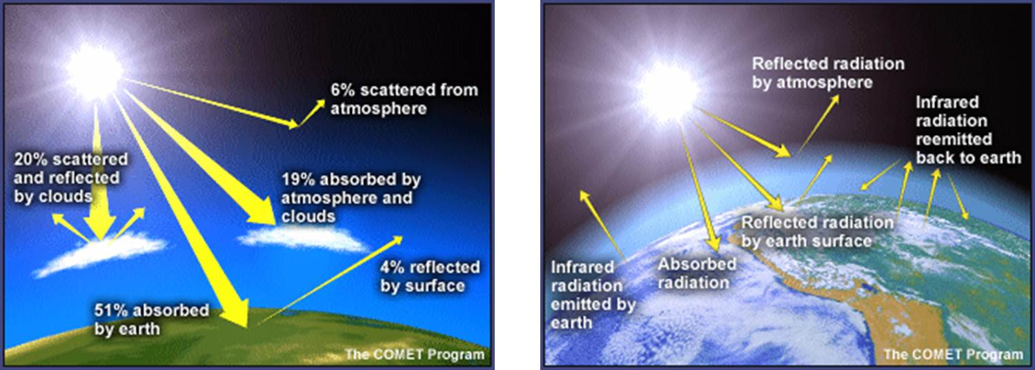
CO₂ & Other GHGs
Multiple sunlight paths (left)
“Greenhouse Effect” (right)
Some IR energy escapes to space, most absorbed by greenhouse gases, warming Earth's atmosphere.
Atmosphere would be ~ 30° C (54° F) colder if it contained no greenhouse gases
www.windows.ucar.edu/tour/link=/earth/climate/greenhouse_effect_gases.html

Slide 23
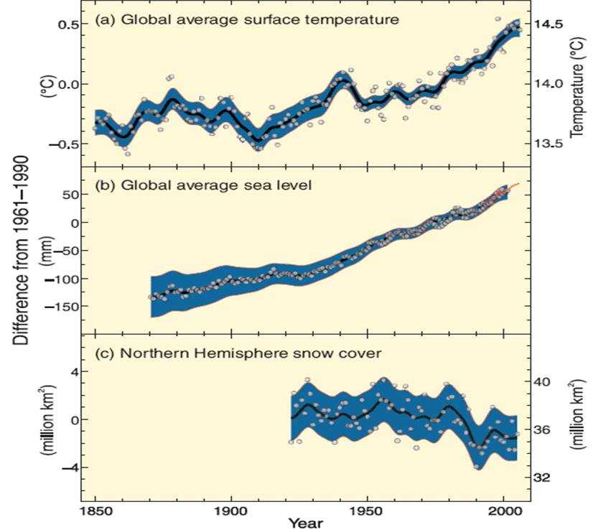
IPCC 2007 report
Warming of climate system unequivocal
  Global average air & ocean temp ↑
  widespread melting of snow & ice
  Global average sea level ↑

Slide 24
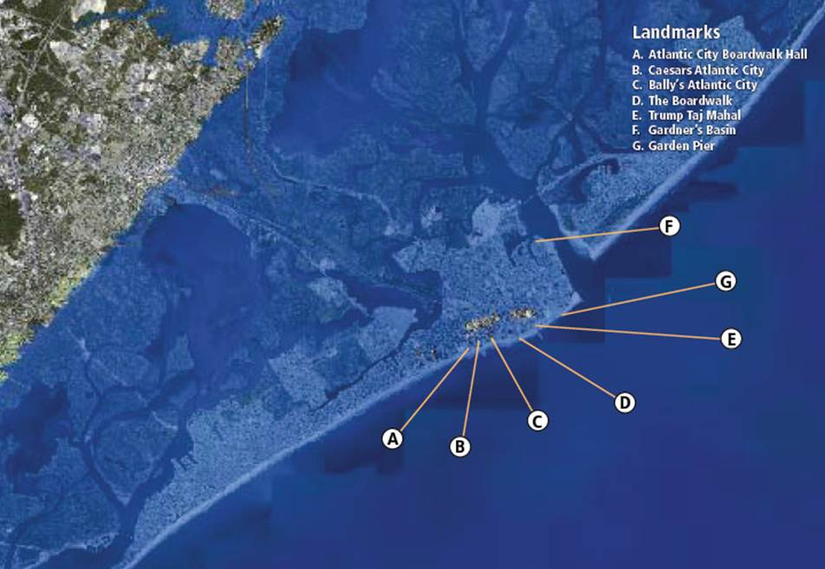
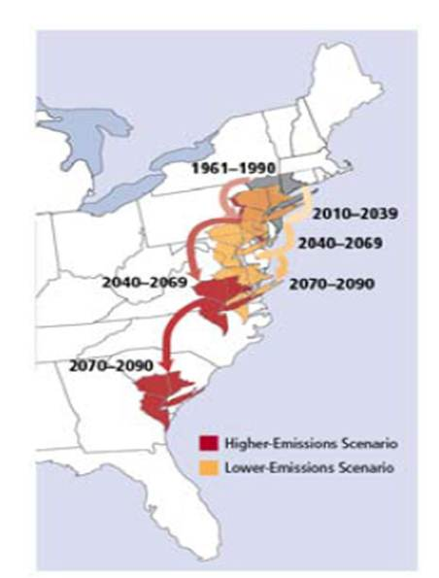
NJ
Union of Concerned Scientists, “New Jersey, Confronting Climate Change in U.S. Northeast”, 2008

Slide 25
Precautionary Principle
Principle #15 of Rio Declaration (Rio Conference 1992)
  In order to protect the environment, the precautionary approach shall be widely applied by States according to their capabilities. Where there are threats of serious or irreversible damage, lack of full scientific certainty shall not be used as a reason for postponing cost-effective measures to prevent environmental degradation.
www.gdrc.org
Notes:
Don’t need certainty before we act!

Slide 26
Solutions
Bans
End-of-Pipe Control
Market Based control
Source Reduction
Reuse
Recycling
Life Style
Efficiency

